Slide 1
https://vimeo.com/438656939/bf2ab9a842

Slide 2
Cutting tube

Slide 3
Choose tube material – Gold / Pt / Gold-Pd – melting temperature varies with the ratio / …
Find a steel stick which fits perfectly with the tube and put the stick into the tube to prevent deform the tube during cutting (especially gold is easy to deform).
Consider that some part can be lost, measure 1 ~ 1.2 cm and gently cut by blade to prevent deformation of the tube.
Cut about half around the tube and make sure steel stick is put until the line you made by the blade.
Stress on the score break the tube with confidence but carefully not to deform the round tube end. If it does not break all, bent several times then you can perfectly break the tube!

Slide 4
Annealation
Annealation is the process to remove dirt and other elements on the tube which keep from contamination. The flame can burn elements such as carbon or water on the temperature around 1700.

Slide 5
Prepare long enough ceramic stick which fits with your tube.
Turn on the gases. Rotate the quarter of gas valve of H2 and O2. When you rotate the valve, the gas gauge will rise. Make sure switch the mark from off to on.
Red valve is hydrogen and green valve is oxygen. First, Hydrogen valve must turn on a little bit. Unless there is a risk of explosion. Then, you make a spark with the spark maker. And then you can turn on the oxygen valve very gently until you can see the small blue flame from the discharge area.
Put on your tube on the ceramic stick. Heating the tube until it looks red. It takes only literally about a second. The tube melt in 3 seconds with the flame, so make sure you don’t heat the tube too long. Repeat this step about 3 or 4 times.
Tube is really hot, be careful not to touch it. Ceramic stick is low heat conductor but heated part is hot, so be careful.
When you turn off, the order is opposite. First, You must turn off the oxygen. Then, turn off the oxygen. Double-check.
Turn off the gas tank both of H2 and O2. Make sure switch the mark from on to off. Time goes by, the gas gauge will go down.
Wait until the tubes cool down after two or three minutes from the annhilation, make sure do not contaminate the tubes with hands or other materials.

Slide 6
Welding-prep
To symmetrically enclose the tube, you will use the tools.

Slide 7
Put a steel stick into the tube with leaving about 2mm to enclose perfectly and not to be ripped.
Adjust hole and fix the tube.
Enclose about half with the machine.
Pick a flat without pattern pliers and pinch edges symmetrically make 3 edges. Not too deep, not to rip, not to make a hole between edges.
To weld effectively, cut the edges downward or flat from the center.
Now you are ready to weld.

Slide 8
Welding
To symmetrically enclose the tube, you will use the tools.

Slide 9
Turn on the welding machine. The button is right behind.
Once you use, pen tip goes round and oxidized (color purple or dark). Put out the pen and sharpening pen tip to accurately weld by diamond disc and check with the magnifier. When you push little black switch, diamond disc will turn on.
Adjust pen tip length, fits with right standard.
Put the pen in where it was and adjust focus.
When you touch the screen or click the round button, the monitor will turn on. Power and time varies with thickness and metal type. Pt – xx / gold-pd would be gold setting.
In the monitor bottom, there are five modes about welding type. Normally stick to the left first one.
Make sure turn on the Argon gas to prevent oxidation of metal during welding.
Now the tong is negative conductive and pen is positive conductive. When they meet, the spark comes out.
The spark is harmful for eyes, so let others in the lab to know that you are welding so that they do not look the welding scene. See through the lens is safe.
Welding

Slide 10
Flattening

Slide 11
Using #8 metal (smaller number, large diameter), put the capsule into the hole with the welded side to the top.
With the blank metal rounded edge, makes edge not to be pointy. Cause it can be ripped when they extruded.
Once you adjust the edges, push an edge one by one, little by little with the press.
When you done with the #8 metal, do it again with the #9.
Then put a blank metal into the hole and put the capsule with the welded side to the bottom holding by round edge blank metal.
Then push hard and you can feel a little bit compressed.
If something is stucked, hit the stick gently with the hammer.
Check the flattened side and repeat press until enough flattened.

Slide 12
Making a sleeve

Slide 13
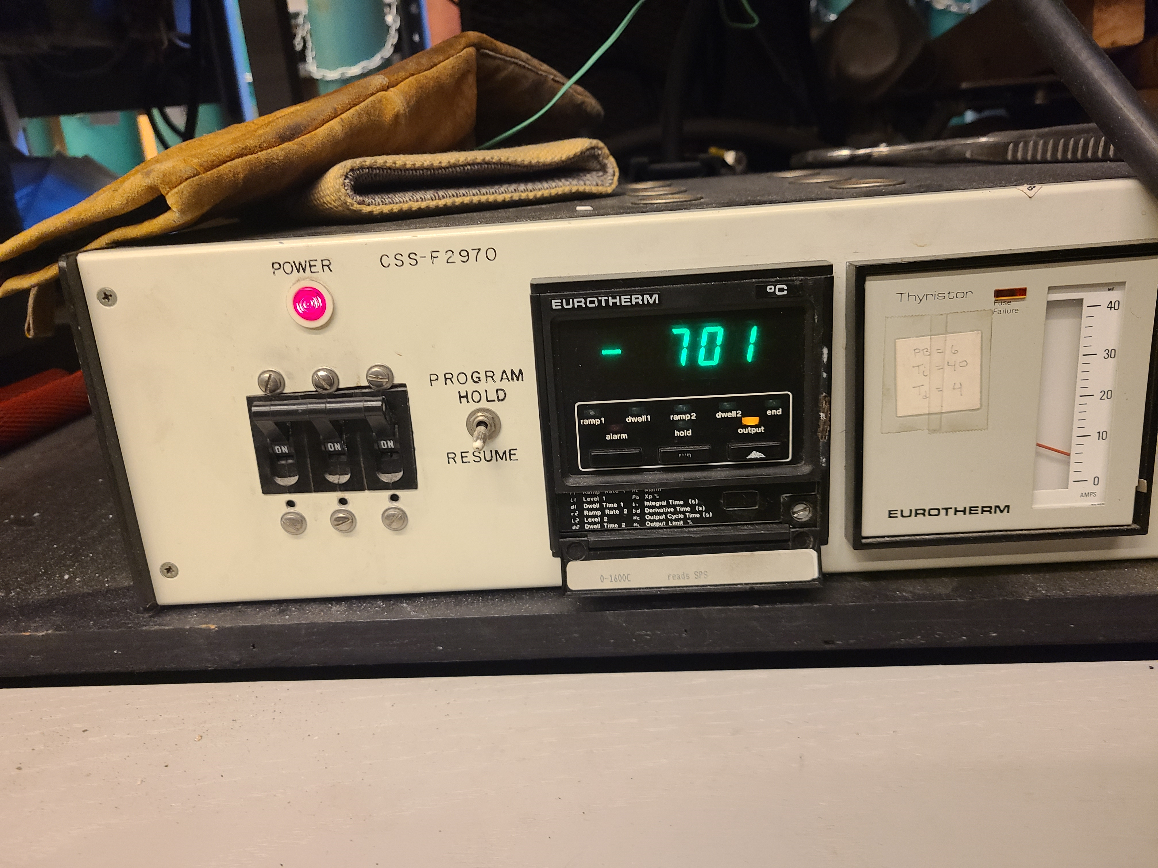
Turn on the oven and increase temperature to around 400 with the output button (Lower than target temperature to adjust oven and then increase temperature step by step).
Clean the metal hole with the brush. Make sure there is no dirt inside.
Check the recipe for your sleeve, weigh and prepare it. Black toner is a bond and make sure not to over the recipe amount.
- For CaF2 sleeve: CaF2 (5.75g) / BN (0.25g) / toner (0.15g) / 700C 25 min
Spary the lubricant inside the hole and set the metals with funnel. Put the mandrel inside the metal and put the stick as a guide and pour the ingredients.
Check the joint is not seen otherwise push hard.
Check the recipe pressure.
Except two, make sure every valve is closed.
Start pressure until your target pressure. Make sure the stick is in cente.
Wait about 10 seconds and release the pressure gently with two hands.
Then remove one and give a pressure to pull out the sleeve.
Decrease
Increase temperature
On/off switch

Slide 14
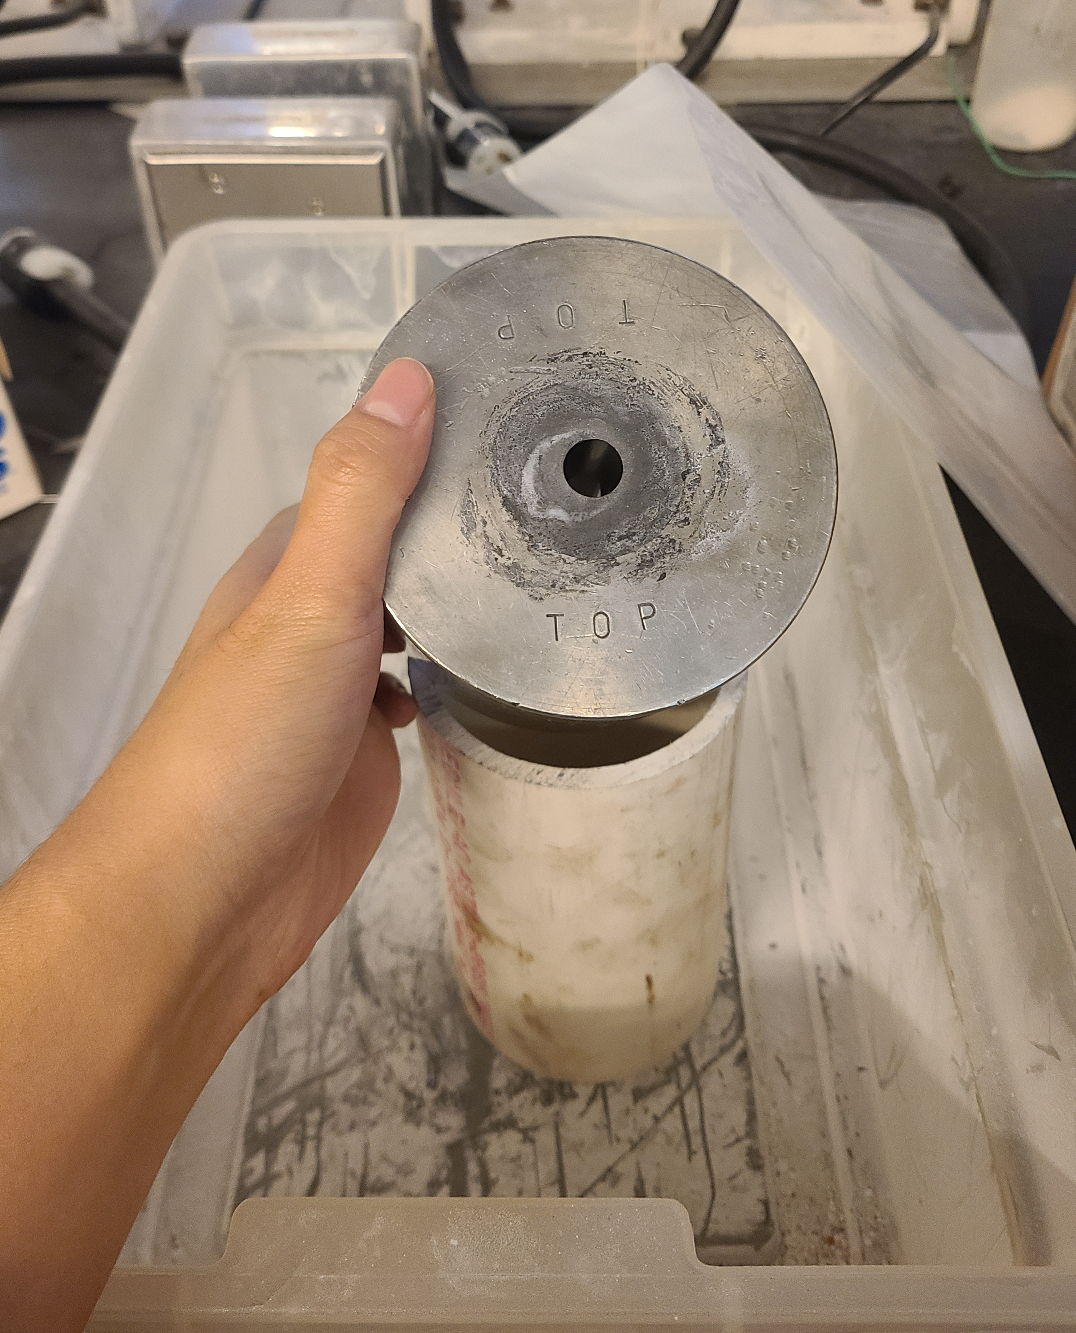
Turn on the oven and increase temperature to around 400 with the output button (Lower than target temperature to adjust oven and then increase temperature step by step).
Clean the metal hole with the brush. Make sure there is no dirt inside.
Check the recipe for your sleeve, weigh and prepare it. Black toner is a bond and make sure not to over the recipe amount.
- For CaF2 sleeve: CaF2 (5.75g) / BN (0.25g) / toner (0.15g) / 700C 25 min
Spary the lubricant inside the hole and set the metals with funnel.
Put the mandrel inside the metal and put the stick as a guide and pour the ingredients.
Check the joint is not seen otherwise push hard.
Check the recipe pressure.
Except two, make sure every valve is closed.
Start pressure until your target pressure. Make sure the stick is in cente.
Wait about 10 seconds and release the pressure gently with two hands.
Then remove one and give a pressure to pull out the sleeve.
Decrease
Increase temperature
On/off switch

Slide 15
MgO assembly

Slide 16
Yellowish stick – MgO (first top drawer) / White stick – Al2O3 (second top drawer) : not to be confused, make sure name on the stick with the pencil
MgO stick with the little hole in the middle will be drilled, which makes it easier to start drilling.
Put the stick into the stationery until the end (not to wiggle) and adjust them not to move. With the blank metal around it, push hard apposite direction.
Put the drill which corresponds to your capsule diameter. There are Tungsten and Steel drill bit, steel is better for MgO. Put the drill-bit.
Move right and left without the black bolt and fastening bolt once you adjust the location right in front of the stick.
Turn on the switch and adjust the speed.
Then rotate and drill bit with your right hand very gently. If the diameter is too large, Al2O3 is harder than MgO. Try with Al2O3.
After make the hole, cut the MgO stick fits with your capsule by the blade.
Put the drill into the hole and make sure the hole is fully penetrated. And flatten the edge with the sandpaper.
Then cut the solid MgO stick as a 0.7mm thick disc for blocking from meeting with capsule and TC.
When you done with your work, clean with the black vacuum cleaner.

Slide 17
Using piston cylinder

